Slide 2
OBJECTIVES OF THE RESEARCH WORK:
To perform numerical simulation using Finite Element Analysis (FEA) of erosion process in AJM with sea sand & mining ore as abrasive and mild steel as work piece material.
To identify the process parameters to be controlled and response variables to be studied in the Design of Experiments (DoE).
To select DoE methods/ types to be performed.
To perform the experiments on mild steel flats using sea sand and mining ore as abrasive material.
To analyze the data of process parameters and response variables obtained from the experiments.
To prescribe optimum process parameters in machining the mild steel flats.

Slide 3
Six-month activities carried in AJM research during sixth DRC.
1. Mathematical model proposed material removal rate prediction in AJM with seashore sand and SiC abrasive
2. Application of Taguchi L27 Orthogonal array for MRR Optimization in Abrasive Jet Machining of mild steel with seashore sand as abrasive
Conducted experimental trials on mild steel plates of 2 mm thickness by randomly selecting time of application of abrasive air jet on mild steel plates.
Done regression analysis to find the effect of each control factors & their interactions on MRR
3. Analysis of kerf tapers obtained by above experimental trials and proposed method to substantially reduce this kerf taper
Kerf taper analysis was done to determine the effect of control factors on this kerf taper.
Proposed a method to reduce the kerf taper and conducted the experimental trials to obtain these kerf tapers.
Comparative analysis on kerf taper was done.
Design changes in AJM machine to handle tilmati sand and mining ore as abrasive material
Physical and chemical analysis of tilmati sand and iron ore
Design changes in abrasive storage and dispensing tank
Goal: Modification to handle all types of abrasives and to accurately control AFR

Slide 4
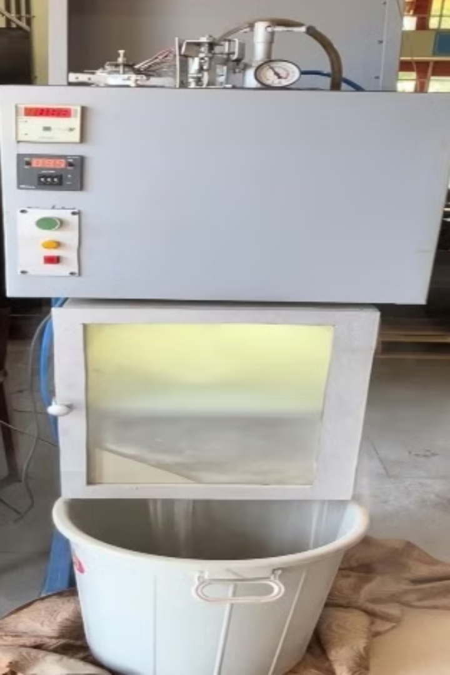
1.Material Removal Rate Prediction in AJM
Research Focus
Developing an empirical analytical model to predict Material Removal Rate (MRR) in Abrasive Jet Machining
Abrasive Materials
Testing with both seashore sand and Silicon Carbide (SiC)
abrasives
Target Materials
Validation on mild steel and Ti-6Al-4V alloy specimens
Application Goal
Ensuring model accuracy for real manufacturing applications

Slide 5
Understanding Abrasive Jet Machining (AJM)
High-Velocity Abrasive Particles
Precise Material Removal
Material Removal Rate (MRR)
• Uses high-speed jet of abrasive particles
• Focused, controlled abrasive stream
• Critical process parameter
• Common materials: silicon carbide, aluminium oxide
• Enables accurate, localized machining
• Key to optimization
• Designed for hard and brittle workpieces
• Suitable for diverse industrial applications
• Determines efficiency and cost-effectiveness

Slide 6
Innovative Approach: Seashore Sand as Abrasive
Seashore Sand Properties
Particle Analysis Insights
Process Benefits
Unconventional abrasive material with varied particle shapes
Diverse particle shapes analyzed using equivalent spherical diameter
Enhanced versatility in AJM applications
Cost-effective alternative to traditional abrasives
Enhanced understanding of abrasive characteristics
Significant reduction in operational costs
Environmentally sustainable option
Improved accuracy in material calculations
Improved process optimization potential

Slide 7





Key Components of the Analytical Model
1
Equivalent Spherical Diameter
2
Air Velocity Calculation
3
Particle Velocity Estimation
4
Material Removal per Impact
5
Correction Factor Application
Fig.1. These components form the backbone of innovative MRR prediction model.

Slide 8
Experimental Setup and Methodology
Custom-Built AJM Machine
Variable Parameters
Taguchi Methodology
Abrasive flow rate adjustments
Implemented L9 orthogonal array design
Specially designed for AJM experiments
Air pressure variations
Optimized number of experimental trials
Custom configuration for precise control
Multiple nozzle diameter settings
Systematic parameter variation approach
Stand-off distance

Slide 9
Control Factors and Response Variables
Control Factors
Response Variable
AJM Parameter | Level 1 | Level 2 | Level 3
Air Pressure (bar) | 5.515 | 6.5 | 8.0
Standoff Distance (mm) | 2 | 3 | 4
Nozzle Diameter (mm) | 2 | 2.5 | 3
AFR (g/min) | 46.8 | 283.8 | 470
Material Removal Rate (MRR)

Slide 10
Table 1. Experimental Results Table
Trial No | Pressure P1 ( bar) 1 | Dia. of Nozzle d_{N} (mm) 2 | Abrasive flow rate AFC (g/min) 3 | Standoff distance SoD x (mm) 4 | Initial weight of workpiece Wi ( g) 5 | Time of machining t (s) 6 | Final weight of workpiece Wf (g) 7 | Actual Material removal rate MRR (kg/s) 8
1 | 5.515 | 2 | 46.8 | 2 | 48.064 | 300 | 47.818 | 0.000294
2 | 5.515 | 2.5 | 283.8 | 3 | 78.17 | 480 | 77.932 | 0.000496
3 | 5.515 | 3 | 470 | 4 | 78.485 | 330 | 78.17 | 0.000955
4 | 6.5 | 2 | 470 | 3 | 49.759 | 330 | 49.546 | 0.000645
5 | 6.5 | 2.5 | 46.8 | 4 | 77.702 | 570 | 77.354 | 0.000611
6 | 6.5 | 3 | 283.8 | 2 | 77.932 | 360 | 77.702 | 0.000639
7 | 8 | 2 | 283.8 | 4 | 45.948 | 360 | 45.755 | 0.000536
8 | 8 | 2.5 | 470 | 2 | 78.647 | 270 | 78.485 | 0.0006
9 | 8 | 3 | 46.8 | 3 | 79.048 | 420 | 78.647 | 0.000955

Slide 11
Key Observations: Mild Steel with Seashore Sand
Pressure and MRR
Nozzle Diameter Impact
Abrasive Flow Rate
Higher pressure → Increased Material Removal Rate
Larger nozzle diameter → Higher MRR
Higher AFR →
Increased MRR
Consistent across all pressure levels
Optimal range identified

Slide 12
Sand Particle Analysis
Mesh
Mean Size
% Proportion
Equivalent size
Key Distribution Data
• Particles in -60 to +100 mesh range: 84.5%
-20 to
+ 40
40
1.8
0.72
• Highest concentration in -80 to +100 mesh: 42.90%
• Lowest concentration in -20 to +40 mesh: 1.8%
-40 to
+ 60
50
6.4
3.2
-60 to
+ 80
70
41.6
29.12
-80 to
+ 100
90
42.90
38.61

Slide 13
Particle Shape Analysis
Shape Distribution
Final Result
Triangle: 0.4135% (Ci: 0.00649)
Particle diameter: 0.2566 mm
Square: 2.7064% (Ci: 0.00538)
Hexagon: 14.7242% (Ci: 0.03804)
Circle: 39.9187% (Ci: 0.1247)
Key Parameters
• Shape distribution percentages
• Circularity index (Ci)
• Final particle diameter

Slide 14
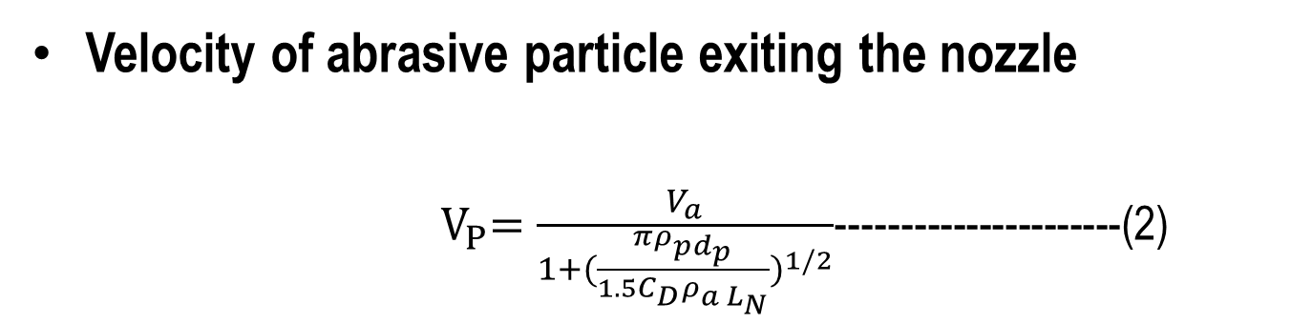
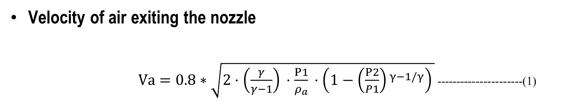
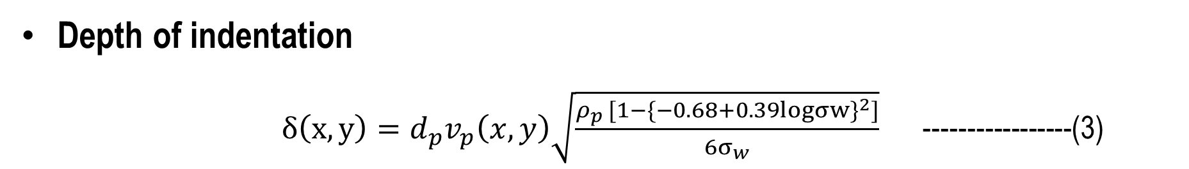
Velocity of air exiting the nozzle
$Va​=0.8∗\sqrt{2⋅\left(\frac{γ}{γ−1}\right)​⋅\frac{P1}{ρ_{a}}​⋅\left(1−{\left(\frac{P2​}{P1}\right)​}^{γ−1/γ}\right)​}$ ----------------------(1)
Velocity of abrasive particle exiting the nozzle
${ V}_{P}=\frac{V_{a}}{1+({\frac{πρ_{pd_{p}}}{1.5C_{D}ρ_{a L_{N}}})}^{1/2}}$----------------------(2)
Depth of indentation
$δ\left(x,y\right)=d_{p}v_{p}\left(x,y\right)\sqrt{\frac{ρ_{p }{[1−\{−0.68+0.39logσw\}}^{2}]}{6σ_{w}}}$ -----------------(3)
Volume of indentation/impact
V_{i} ≈ (πr_{p}²∂min) +( πr_{p}²(∂max-∂min)/2) --------------------(4)

Slide 15
Mass of material removed by impact (M):
M=V_{i} *ρ_{w} Where ρ_{w} is density of worksurface material.-----------(5)
Determination of theoretical number of impacts of abrasive particles acting on worksurface per second based on VP & x
*Time taken by abrasive particle exited from nozzle to reach worksurface t_{p}=x/ V_{p}
* Theoretical number of impacts /sec N=1/t_{p} , (P. M. Khodke et al. (1996))
* Theoretical number of impact /sec is obtained from AFR
* Actual number of impacts/sec is obtained from actual MRR obtained from experimental trials
Correction factor K =(Corrected impacts/sec based on actual MRR)/(theoretical impacts /sec based on VP & x)
Corrected MRR = MRRTH*[(Corrected impacts/sec)/(theoretical impacts /sec based on AFR)]
Or MR/impact *K*(theoretical impacts /sec based on VP & x)

Slide 16
Table 2. For the trials taken values of theoretical & corrected impacts/sec, MRR & correction factor K
Trial No. | Pressure (bar) 1 | d_{N} (mm) 2 | SoD (mm) 3 | AFR (g/min) 4 | MRR without correction factor K (kg/s) 5 | Theoretical impact/ sec based on AFR 6 | Corrected impact/sec based on actual MRR 7 | Theoretical impact/sec based on Vp & x 8 | Correction factor K 9 | Corrected MRR In Kg/s 10
1 | 5.515 | 2 | 2 | 46.8 | 0.000227 | 1044 | 1349 | 54963 | 0.0245 | 0.000294
2 | 5.515 | 2.5 | 3 | 283.8 | 0.00148 | 4050 | 1355 | 36642 | 0.0370 | 0.000496
3 | 5.515 | 3 | 4 | 470 | 0.00257 | 4658 | 1731 | 27481 | 0.0630 | 0.000955
4 | 6.5 | 2 | 3 | 470 | 0.00307 | 10481 | 2202 | 41219 | 0.0534 | 0.000645
5 | 6.5 | 2.5 | 4 | 46.8 | 0.000316 | 668 | 1290 | 30914 | 0.0418 | 0.000611
6 | 6.5 | 3 | 2 | 283.8 | 0.00135 | 2813 | 1328 | 61828 | 0.0215 | 0.000639
7 | 8 | 2 | 4 | 283.8 | 0.00252 | 6329 | 1344 | 35678 | 0.0377 | 0.000536
8 | 8 | 2.5 | 2 | 470 | 0.00274 | 6708 | 1471 | 71356 | 0.0206 | 0.0006
9 | 8 | 3 | 3 | 46.8 | 0.000294 | 464 | 1507 | 47570 | 0.0317 | 0.000955

Slide 17
Figure 2. Graph of correction factor K v/s dN for P=5.515 bar & SoD= 2, 3, 4 mm
Figure 3. Graph of correction factor K v/s dN for P1=6.5 bar & SoD= 3, 4, 2 mm
Figure 4. Graph of correction factor K v/s dN for P=8 bar & SoD= 4, 2, 3 mm

Slide 18
Table 3. Values of K for various values of dN based on trendline equations
Y=Correction factor X=dN Nozzle diameter in mm
P=5.515 bar SoD=2, 3, 4 mm Y= 0.0385X- 0.0546
dN | 2 | 2.5 | 3 | 3.5 | 4 | 4.5 | 5
K | 0.0224 | 0.04165 | 0.0609 | 0.08015 | 0.0994 | 0.11865 | 0.1379
P=6.5 bar SoD=3, 4, 2 mm Y= - 0.0139X+0.1187
dN | 2 | 2.5 | 3 | 3.5 | 4 | 4.5 | 5
K | 0.0549 | 0.03895 | 0.023 | 0.00705 | -0.0089 | -0.02485 | -0.0408
P=8 bar SoD=4, 2, 3 mm Y=- 0.006X+ 0.045
dN | 2 | 2.5 | 3 | 3.5 | 4 | 4.5 | 5
K | 0.033 | 0.03 | 0.027 | 0.021 | 0.018 | 0.015 | 0.033

Slide 19
Table 4. Comparison table of Theoretical & Actual MRR after using K as per trendline equation
Trial No. | Pressure P (bar) 1 | Act MRR (kg/s) 2 | d_{N} mm 3 | SoD x mm 4 | AFR g/min 5 | K as per trendline equation 6 | Theoretical impact/Sec 7 | Actual impact/ Sec 8 | Material removed per impact Kg/impact 9 | Theoretical MRR (kg/s) 10
1 | 5.515 | 0.000294 | 2 | 2 | 46.8 | 0.0224 | 54963 | 1231 | 2.18E-07 | 0.000268
2 | 5.515 | 0.000496 | 2.5 | 3 | 283.8 | 0.04165 | 36642 | 1526 | 3.66E-07 | 0.000558
3 | 5.515 | 0.000955 | 3 | 4 | 470 | 0.0609 | 27481 | 1674 | 5.51E-07 | 0.000923
4 | 6.5 | 0.000645 | 2 | 3 | 470 | 0.0549 | 41219 | 2263 | 2.93E-07 | 0.00066
5 | 6.5 | 0.000611 | 2.5 | 4 | 46.8 | 0.03895 | 30914 | 1204 | 4.73E-07 | 0.000570
6 | 6.5 | 0.000639 | 3 | 2 | 283.8 | 0.023 | 61828 | 1422 | 4.81E-07 | 0.000684
7 | 8 | 0.000536 | 2 | 4 | 283.8 | 0.033 | 35678 | 1177 | 3.99E-07 | 0.000470
8 | 8 | 0.0006 | 2.5 | 2 | 470 | 0.03 | 71356 | 2141 | 4.08E-07 | 0.000873
9 | 8 | 0.000955 | 3 | 3 | 46.8 | 0.027 | 47570 | 1284 | 4.08E-07 | 0.000524

Slide 20
Graphs of actual MRR v/s theoretical MRR for experimental trials

Slide 21
Ti-6Al-4V Alloy Analysis
1
Data Collection
2
Parameter Examination
• Based on K. Nagendra Prasad study (2017)
• Focus on experimental measurements
• Comprehensive dataset analysis
• Air pressure variations studied
• Nozzle diameter effects measured
• Standoff distance impact analyzed
• MRR as primary output variable
3
Model Application
• Applied analytical model to Ti-6Al-4V focused on MRR prediction
• Validated against experimental data

Slide 22
Table 5. Experimental results
Trail No | Air Pressure (bar) | Standoff distance (mm) | Nozzle Diameter (mm) | MRR Actual (gram/sec)
1 | 6 | 3 | 2 | 8.37E-05
2 | 6 | 3 | 3 | 0.00072
3 | 6 | 3 | 4 | 0.001133
4 | 6 | 6 | 2 | 0.000122
5 | 6 | 6 | 3 | 0.00152
6 | 6 | 6 | 4 | 0.002506
7 | 6 | 9 | 2 | 0.000126
8 | 6 | 9 | 3 | 0.001996
9 | 6 | 9 | 4 | 0.002407
10 | 8 | 3 | 2 | 0.000139
11 | 8 | 3 | 3 | 0.000894
12 | 8 | 3 | 4 | 0.002555
13 | 8 | 6 | 2 | 0.000463
14 | 8 | 6 | 3 | 0.001637
Trail No | Air Pressure (bar) | Standoff distance (mm) | Nozzle Diameter (mm) | MRR Actual (gram/sec)
15 | 8 | 6 | 4 | 0.004276
16 | 8 | 9 | 2 | 0.000134
17 | 8 | 9 | 3 | 0.002464
18 | 8 | 9 | 4 | 0.002765
19 | 10 | 3 | 2 | 0.000157
20 | 10 | 3 | 3 | 0.001438
21 | 10 | 3 | 4 | 0.001761
22 | 10 | 6 | 2 | 0.000976
23 | 10 | 6 | 3 | 0.002489
24 | 10 | 6 | 4 | 0.003111
25 | 10 | 9 | 2 | 0.000123
26 | 10 | 9 | 3 | 0.000123
27 | 10 | 9 | 4 | 0.003089

Slide 23
Key Observations: Ti-6Al-4V Alloy with SiC
Air Pressure Impact
Nozzle Diameter Correlation
Material Removal Rate (MRR) generally increased with air pressure, showing highest efficiency at 10 bar compared to 6 and 8 bar settings.
Larger nozzle diameters (4 mm) consistently produced higher MRR values compared to smaller diameters (2-3 mm), with maximum MRR of 0.00427647 g/s observed.
Standoff Distance Effects
Parameter Optimization
Optimal MRR achieved at 6 mm standoff distance across most pressure settings, with diminishing returns at 9 mm distance.
Best material removal performance observed with combination of 8 bar pressure, 6 mm standoff distance, and 4 mm nozzle diameter (Trial 15).

Slide 24
Table 8. Analysis of MRR at d_{N}= 2 mm and x= 3 mm
P (bar) | Va (m/s) | Vp (m/s) | d_{N} (mm) | X (mm) | MR/ imp Th | Act MRR Kg/S | imp/s Th | imp/s Act | K
6 | 916.3 | 201.4 | 2 | 3 | 3.3E-08 | 0.000084 | 67125 | 2545 | 0.038
8 | 1119.4 | 246. | 2 | 3 | 4E-08 | 0.00014 | 81997 | 3459 | 0.042
10 | 1298.6 | 285.4 | 2 | 3 | 4.7E-08 | 0.00016 | 95129 | 3373 | 0.035
Initial K Calculation
Determined correction factor K for multiple experimental conditions
Table 9. Analysis of MRR at d_{N}= 2mm and x= 6mm
P (bar) | Va (m/s) | Vp (m/s) | d_{N} (mm) | X (mm) | MR/ imp Th | Act MRR Kg/S | imp/s Th | imp/s Act | K
6 | 916.3 | 201.4 | 2 | 6 | 4.0E-08 | 0.00012 | 33562 | 3007 | 0.09
8 | 1119.4 | 246. | 2 | 6 | 5.0E-08 | 0.00046 | 40998 | 9348 | 0.23
10 | 1298.6 | 285.4 | 2 | 6 | 5.8E-08 | 0.00098 | 47564 | 1697 | 0.04
Accounted for variations
in setup parameters
applied across different
test configurations
Table 10. Analysis of MRR at d_{N}= 2mm and x= 9mm
P (bar) | Va (m/s) | Vp (m/s) | d_{N} (mm) | X (mm) | MR/ imp Th | Act MRR Kg/S | imp/s Th | imp/s Act | K
6 | 916.3 | 201.4 | 2 | 9 | 4.9E-08 | 0.000126 | 22375 | 2580 | 0.12
8 | 1119.4 | 246. | 2 | 9 | 6E-08 | 0.000134 | 27332 | 2250 | 0.08
10 | 1298.6 | 285.4 | 2 | 9 | 7E-08 | 0.000123 | 31710 | 1775 | 0.06

Slide 25
Graphs of initial Correction factors K v/s air Pressure with trendline equations for d_{N}=2mm & SoD x=3mm, 6mm & 9mm
Graphical Representation
Plotted K against air pressure
analyzed across various
nozzle diameters
Considered different standoff
distances

Slide 26
Table 9. Data obtained of Th MRR based on correction factors K obtained from trendline equation for d_{N}=2mm, x= 3 mm, 6 mm, 9 mm
Trendline Equations
P (bar) | d_{N} (mm) | X | Act MRR (kg/s) | imp/s Th | K | MR/ imp Th | Th MRR (kg/s)
6 | 2 | 3 | 0.000084 | 67125 | 0.04 | 3.3E-08 | 8.8E-05
8 | 2 | 3 | 0.00014 | 81997 | 0.04 | 4E-08 | 0.00013
10 | 2 | 3 | 0.00016 | 95129 | 0.04 | 4.7E-08 | 0.00017
6 | 2 | 6 | 0.00012 | 33562 | 0.14 | 4.00E-08 | 0.000194
8 | 2 | 6 | 0.00046 | 40998 | 0.12 | 5.00E-08 | 0.000241
10 | 2 | 6 | 0.00098 | 47564 | 0.09 | 5.80E-08 | 0.000250
6 | 2 | 9 | 0.000126 | 22375 | 0.11 | 4.90E-08 | 0.000125
8 | 2 | 9 | 0.000134 | 27332 | 0.08 | 6.00E-08 | 0.000139
10 | 2 | 9 | 0.000123 | 31710 | 0.06 | 7.00E-08 | 0.000123
Derived linear equations for K values
Enabled interpolation for untested
conditions
Created predictive model for K factor

Slide 27
Figure 10. Graphs plotted of Act MRR act v/s Th MRR for d_{N}=2mm,3mm,4mm and SoD=3 mm, 6 mm & 9 mm

Slide 28
Model Validation: Theoretical vs Actual MRR
Mild Steel Performance
Ti-6Al-4V Alloy Results
High correlation between theoretical and actual MRR
Strong correlations across multiple setups
R² value of 0.9761 demonstrates exceptional accuracy
R² values range from 0.8547 to 0.9149
Consistent performance across different experimental conditions
Overall Model Accuracy
High R-squared values for both materials
Reliable predictions for both mild steel and Ti-6Al-4V
Validated effectiveness across different material types

Slide 29

Model Strengths
Particle Shape Consideration
Incorporates diverse abrasive particle geometries
Enhances real-world applicability
Accurate Velocity Calculations
Precise air velocity computation
Detailed particle velocity tracking
Critical for MRR determination
Material Removal Precision
Per-particle impact analysis
Detailed MRR estimation capability
Straightforward Methodology
Simple correction factor calculations
Easy-to-implement theoretical MRR approach

Slide 30

Future Enhancements and Applications
1
CFD Analysis
2
Industrial Applications
• Enhance model accuracy through CFD simulation
• Better understanding of air flow patterns
• Improved particle dynamics modeling
• Optimize manufacturing processes
• Improve production planning
• Enhance machining efficiency
3
Ongoing Research
• Test new materials and abrasives
• Expand process capabilities
• Develop novel applications

Slide 31
2.Application of Taguchi L27 Orthogonal Array for MRR Optimization in
AJM of Mild Steel with Seashore Sand as Abrasive
Problem Statement
Research Focus
Project Scope
Investigation of Abrasive Jet Machining using locally sourced materials for sustainable manufacturing solutions
Utilizing Goan seashore sand as an alternative abrasive medium in AJM processes
Optimization of machining parameters for mild steel plate processing using sustainable abrasive materials
This research aims to bridge the gap between conventional abrasive materials and sustainable alternatives while maintaining machining efficiency.

Slide 32
Research Overview: Sand Abrasives in AJM
Research Motivation
Key Assumptions
Growing need for sustainable and
cost-effective abrasive materials in
industrial machining processes
Uniform grain distribution after
preprocessing
Constant atmospheric conditions during
experimentation
Limited studies on natural mineral
alternatives in precision manufacturing
Negligible nozzle wear in initial phases

Slide 33
LITERATURE SURVEY
Author(s) | Research Summary | Relevance
Suresh et al. | Demonstrated how particle size and pressure affect MRR and taper angle in AJM. | Foundational for optimizing AJM using seashore sand.
Nouhi et al. | Explored the impact of abrasive size and stand-off distance on MRR and surface roughness. | Key to understanding parameter effects in AJM with brittle materials.
Chaitanya et al. | Observed finer abrasives improve surface finish but reduce MRR. | Highlights trade-offs between surface finish and MRR in AJM.
Joel et al. | Studied seashore sand as an affordable abrasive with comparable performance. | Validates the use of seashore sand for cost-effective AJM.
Ghara et al. | Highlighted environmental and cost benefits of using natural abrasives. | Aligns with eco-friendly abrasive selection for AJM.
Venkatesh | Conducted early parametric studies using Design of Experiments (DoE) in AJM. | Provides groundwork for optimizing AJM parameters.
Ambade et al. | Used Taguchi method to optimize MRR for special abrasives in AJM. | Directly aligns with Taguchi L27 array methodology.
Tamilarasan et al. | Applied advanced algorithms for AWJM to reduce kerf taper and improve surface finish. | Demonstrates effective methods for surface and MRR optimization.

Slide 34
Design of Experiments: Methodology
Sample Preparation
Control Parameters
Experimental Design
Sand collected from Benaulim beach sea shore, Goa
Washed ,dried and cleaned with equivalent size of particle as 0.257 mm
Nozzle diameter:
2.0 mm, 2.5 mm, 3.0 mm
Taguchi L27
orthogonal array
Air pressure:
5.515 bar, 6.5 bar,8 bar
3 replications per
condition
Standoff distance:
2 mm, 3 mm, 4 mm
MRR measured with ±0.001g precision balance
Specimens: AISI 1018
mild steel
Abrasive flow rate:
46.8, 283.8 , 470 g/min

Slide 35
Table 1. Experimental data and MRR calculations
Trial No. | P (bar) 1 | d_{N} (mm) 2 | S (mm) 3 | A (g/min) 4 | Weight of the nozzle (g) 5 | Job initial weight Wi (g) 6 | Time T (s) 7 | Job final weight Wf (g) ₈ | Hole upper dia (mm) 9 | Hole bottom dia (mm) 10 | MRR (kg/s) 11
1 | 5.515 | 2 | 2 | 46.8 | 46.542 | 48.669 | 450 | 48.567 | 2.8 | 2.56 | 0.000227
2 | 5.515 | 2 | 2 | 46.8 | 46.542 | 48.567 | 450 | 48.456 | 2.76 | 2.46 | 0.000247
3 | 5.515 | 2 | 2 | 46.8 | 46.542 | 48.456 | 600 | 48.303 | 2.6 | 2.52 | 0.000255
4 | 5.515 | 2.5 | 3 | 283.8 | 38.571 | 51.458 | 330 | 51.233 | 4.52 | 2.78 | 0.000682
5 | 5.515 | 2.5 | 3 | 283.8 | 38.571 | 51.233 | 330 | 51.045 | 4.52 | 2.54 | 0.00057
6 | 5.515 | 2.5 | 3 | 283.8 | 38.49 | 51.045 | 330 | 50.87 | 4.42 | 1.78 | 0.00053
7 | 5.515 | 3 | 4 | 470 | 38.68 | 43.47 | 390 | 43.009 | 5.7 | 3.82 | 0.001182
8 | 5.515 | 3 | 4 | 470 | 38.68 | 43.009 | 390 | 42.597 | 5.6 | 3.72 | 0.001056
9 | 5.515 | 3 | 4 | 470 | 38.489 | 42.597 | 330 | 42.231 | 5.6 | 3.5 | 0.001109
10 | 6.5 | 2 | 3 | 470 | 46.542 | 44.104 | 480 | 43.914 | 3 | 2.9 | 0.000396

Slide 36
Trial No. | P (bar) 1 | d_{N} (mm) 2 | S (mm) 3 | A (g/min) 4 | Weight of the nozzle (g) 5 | Job initial weight Wi (g) 6 | Time T (s) 7 | Job final weight Wf (g) ₈ | Hole upper dia (mm) 9 | Hole bottom dia (mm) 10 | MRR (kg/s) 11
11 | 6.5 | 2 | 3 | 470 | 46.542 | 43.914 | 510 | 43.766 | 2.82 | 2.7 | 0.00029
12 | 6.5 | 2 | 3 | 470 | 46.542 | 43.766 | 510 | 43.612 | 2.8 | 2.6 | 0.000302
13 | 6.5 | 2.5 | 4 | 46.8 | 60.152 | 44.187 | 360 | 43.938 | 4.6 | 3.52 | 0.000692
14 | 6.5 | 2.5 | 4 | 46.8 | 60.152 | 43.938 | 360 | 43.688 | 4.52 | 3.12 | 0.000694
15 | 6.5 | 2.5 | 4 | 46.8 | 60.141 | 43.688 | 360 | 43.409 | 4.1 | 2.92 | 0.000775
16 | 6.5 | 3 | 2 | 283.8 | 38.675 | 35.849 | 360 | 35.435 | 5.38 | 4.1 | 0.00115
17 | 6.5 | 3 | 2 | 283.8 | 38.625 | 35.435 | 330 | 35.065 | 5.38 | 4.14 | 0.001121
18 | 6.5 | 3 | 2 | 283.8 | 38.55 | 35.065 | 300 | 34.735 | 5.36 | 3.54 | 0.0011
19 | 8 | 2 | 4 | 283.8 | 46.542 | 37.656 | 600 | 37.443 | 2.94 | 2.72 | 0.000355
20 | 8 | 2 | 4 | 283.8 | 46.542 | 37.443 | 600 | 37 | 2.92 | 2.86 | 0.000332

Slide 37
Trial No. | P (bar) 1 | d_{N} (mm) 2 | S (mm) 3 | A (g/min) 4 | Weight of the nozzle (g) 5 | Job initial weight Wi (g) 6 | Time T (s) 7 | Job final weight Wf (g) ₈ | Hole upper dia (mm) 9 | Hole bottom dia (mm) 10 | MRR (kg/s) 11
21 | 8 | 2 | 4 | 283.8 | 46.542 | 37.244 | 600 | 37.036 | 2.92 | 2.9 | 0.000347
22 | 8 | 2.5 | 2 | 470 | 38.251 | 43.673 | 330 | 43.355 | 5.04 | 3.82 | 0.000964
23 | 8 | 2.5 | 2 | 470 | 38.174 | 43.355 | 330 | 43.008 | 5.64 | 3.74 | 0.001052
24 | 8 | 2.5 | 2 | 470 | 38.14 | 43.008 | 330 | 42.711 | 5.82 | 3.24 | 0.0009
25 | 8 | 3 | 3 | 46.8 | 59.458 | 48.923 | 300 | 48.573 | 5.62 | 4.52 | 0.001167
26 | 8 | 3 | 3 | 46.8 | 59.458 | 48.573 | 300 | 48.237 | 5.38 | 4 | 0.00112
27 | 8 | 3 | 3 | 46.8 | 59.458 | 48.237 | 300 | 47.856 | 5.4 | 4 | 0.00127

Slide 38
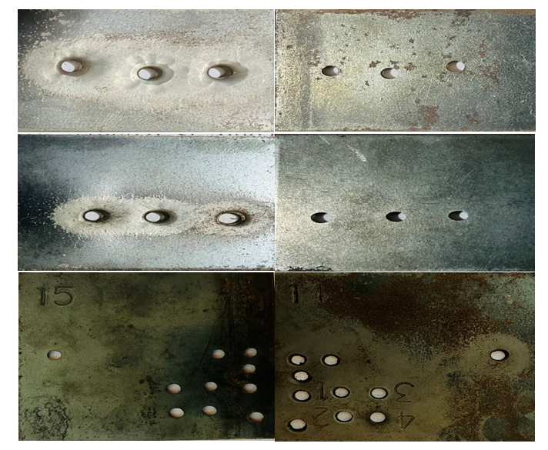
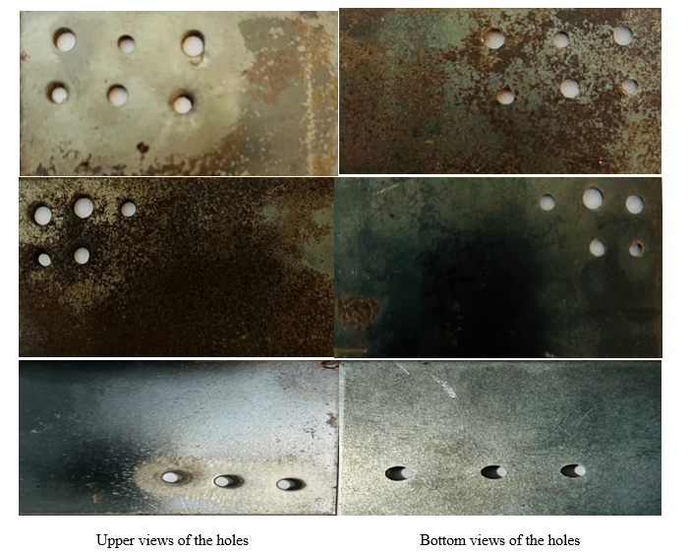
Experimentation results and observations
Fig.1 Upper and bottom views of holes machined by sand abrasive on 2 mm thick mild steel plate

Slide 39
Material Removal Rate (MRR) Analysis
Using Taguchi Methodology for AJM

Slide 40
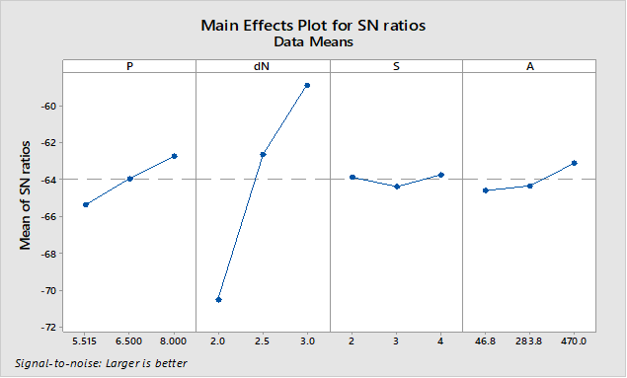
Main Effects Plot for SN Ratios

Slide 41
Key Observations: SN Ratios
Highest SN ratio observed at:
• Air pressure (P) = 8 bar
• Nozzle diameter (dN) = 3 mm
- Stand-off distance (S) shows minimal variation
- Abrasive flow rate (A) = 470 g/min positively impacts MRR

Slide 42
Main Effects Plot for Means

Slide 43
Key Observations: Means
- Mean MRR increases with:
• Air pressure (P), highest at 8 bar
• Nozzle diameter (dN) = 3 mm
- Closer nozzle (lower S) enhances machining
- A = 470 g/min yields the highest MRR

Slide 44
Response Table for SN Ratios
Level | P (bar) | d_{N} (mm) | S (mm) | A (g/min)
1 | -65.35 | -70.49 | -63.87 | -64.59
2 | -63.92 | -62.62 | -64.37 | -64.31
3 | -62.71 | -58.87 | -63.74 | -63.09
δ | 2.65 | 11.61 | 0.63 | 1.50
Rank | 2 | 1 | 4 | 3
- Nozzle diameter (dN) has the most significant impact (δ = 11.61
- Air pressure (P) ranks second (δ = 2.65)
- Stand-off distance (S) has the least impact

Slide 45
Response Table for Means
Level | P (bar) | d_{N} (mm) | S (mm) | A (g/min)
1 | 0.000651 | 0.000306 | 0.000780 | 0.000716
2 | 0.000724 | 0.000762 | 0.000703 | 0.000687
3 | 0.000834 | 0.001142 | 0.000727 | 0.000806
δ | 0.000183 | 0.000836 | 0.000077 | 0.000118
Rank | 2 | 1 | 4 | 3
- Nozzle diameter (dN) has the highest impact (δ = 0.000836)
- Air pressure (P) follows (δ = 0.000183)
- S and A have lesser effects but consistent trends

Slide 46
Conclusion 1
- Nozzle diameter and air pressure are the most influential factors
- Optimization should prioritize dN = 3 mm and P = 8 bar
- High abrasive flow rate (A = 470 g/min) also enhances MRR
- Taguchi methodology provides clear insights for AJM process optimization

Slide 47
Regression Analysis:
- Regression analysis models the relationship between MRR and control factors (P, dN, S, A)
- 9 cases were considered to explore factors and their interactions
- R-squared values assess model fit and significance of factors

Slide 48
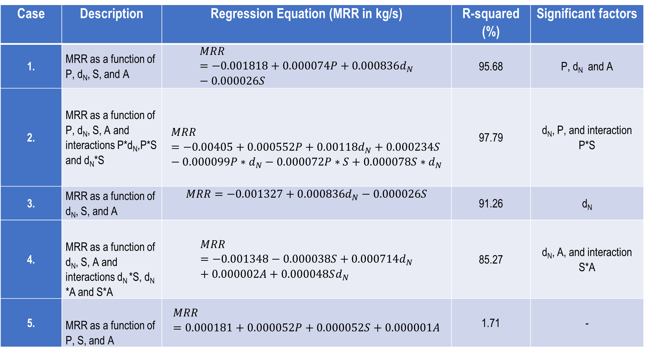
Table 2. Regression analysis equations for nine cases
Case | Description | Regression Equation (MRR in kg/s) | R-squared (%) | Significant factors
1. | MRR as a function of P, d_{N}, S, and A | $$MRR=−0.001818+0.000074P+0.000836d_{N}−0.000026S$$ | 95.68 | P, d_{N} and A
2. | MRR as a function of P, d_{N}, S, A and interactions P*d_{N},P*S and d_{N}*S | $$MRR=−0.00405+0.000552P+0.00118d_{N}+0.000234S−0.000099P∗d_{N}−0.000072P∗S+0.000078S{∗d}_{N}$$ | 97.79 | d_{N}, P, and interaction P*S
3. | MRR as a function of d_{N}, S, and A | $$MRR=−0.001327+0.000836d_{N}−0.000026S$$ | 91.26 | d_{N}
4. | MRR as a function of d_{N}, S, A and interactions d_{N} *S, d_{N} *A and S*A | $$MRR=−0.001348−0.000038S+0.000714d_{N}+0.000002A+0.000048Sd_{N}$$ | 85.27 | d_{N}, A, and interaction S*A
5. | MRR as a function of P, S, and A | $$MRR=0.000181+0.000052P+0.000052S+0.000001A$$ | 1.71 | -

Slide 49
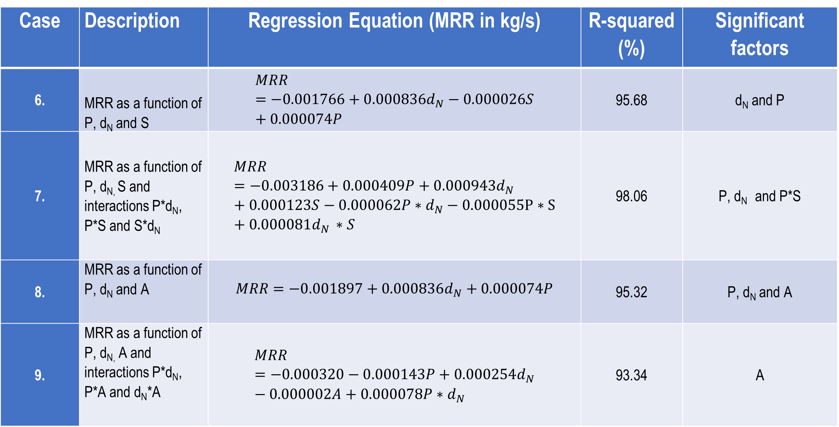
Case | Description | Regression Equation (MRR in kg/s) | R-squared (%) | Significant factors
6. | MRR as a function of P, d_{N} and S | $$MRR=−0.001766+0.000836d_{N}−0.000026S+0.000074P$$ | 95.68 | d_{N} and P
7. | MRR as a function of P, d_{N,} S and interactions P*d_{N}, P*S and S*d_{N} | $$MRR=−0.003186+0.000409P+0.000943d_{N}+0.000123S−0.000062P∗d_{N}−0.000055P∗S+0.000081d_{N }∗S$$ | 98.06 | P, d_{N} and P*S
8. | MRR as a function of P, d_{N} and A | $$MRR=−0.001897+0.000836d_{N}+0.000074P$$ | 95.32 | P, d_{N} and A
9. | MRR as a function of P, d_{N,} A and interactions P*d_{N}, P*A and d_{N}*A | $$MRR=−0.000320−0.000143P+0.000254d_{N}−0.000002A+0.000078P∗d_{N}$$ | 93.34 | A

Slide 50
Key Results Overview
- Case 1: P, dN, and A significantly influence MRR
(R² = 95.68%).
- Case 2: Interactions (P*dN, P*S, dN*S) enhance model
(R² = 97.79%).
- Case 3: dN remains critical (R² = 91.26%).
- Case 4: dN, S, A, and their interactions show significance
(R² = 85.27%).

Slide 51
Observations: Case 5 to Case 9
Case 5: Minimal impact of P, S, and A alone (R² = 1.71%)
Case 6: Strong model with P, dN, and S (R² = 95.68%)
Case 7: Strong model with P, dN, and P*S interaction (R² = 98.06%)
Case 8: Strong model with P, dN, and A (R² = 95.32%)
Case 9: Strong model with A (R² = 93.34%)

Slide 52
Fig. 2. Actual MRR v/s MRR predicted as per Case 1
Fig. 3. Actual MRR v/s MRR predicted as per Case 2

Slide 53
Fig. 4. Actual MRR v/s MRR predicted as per Case 3
Fig. 5. Actual MRR v/s MRR predicted as per Case 4

Slide 54
Fig. 6. Actual MRR v/s MRR predicted as per Case 5
Fig. 7. Actual MRR v/s MRR predicted as per Case 6

Slide 55
Fig. 8. Actual MRR v/s MRR predicted as per Case 7
Fig. 9. Actual MRR v/s MRR predicted as per Case 8

Slide 56
Fig. 10. Actual MRR v/s MRR predicted as per Case 9

Slide 57
Conclusion 2:
- dN and P consistently emerge as critical factors
- Interactions between factors (e.g., P*dN, S*A) play significant roles
- Regression analysis validates the importance of optimizing these factors
- Insights support efficient and precise AJM process development

Slide 58
Final Conclusion: Sustainable Use of Goan Seashore Sand in AJM
Exploring the Potential of Eco-Friendly Abrasives in Industrial Machining

Slide 59
Key Findings
- Demonstrated Goan seashore sand as a cost-effective abrasive.
- Optimal parameters: 3 mm nozzle diameter, 8 bar pressure, 470 g/min flow rate.
- High predictive accuracy from regression models.
- Reduced kerf taper in some trials, efficient nozzle wear management.

Slide 60
Industrial Applications
- Cost-efficient alternative to conventional abrasives
- Reduces operational costs while maintaining efficiency
- Aligns with global sustainability goals
- Beneficial for SMEs in coastal regions
- Supports local economies by utilizing natural resources

Slide 61
Future Directions
- Explore alternatives like mining ore and river sand
- Study long-term nozzle wear and environmental impacts
- Apply advanced optimization techniques (e.g., machine learning)
- Refine predictive models for MRR, kerf taper, and nozzle wear

Slide 62
Outcomes:
- Promotes sustainable and cost-effective machining solutions
- Demonstrates technical feasibility of seashore sand in AJM
- Encourages exploration of eco-friendly manufacturing alternatives
- Sets a foundation for future research and industrial adoption

Slide 63
3.Reduction of Kerf Taper in Abrasive Jet Machining of Mild Steel
Exploring Stand-off Distance Reduction and Impingement Time Optimization

Slide 64
Problem Statement:
• Kerf taper significantly impacts dimensional accuracy in AJM
• Caused by abrasive jet divergence, leading to discrepancies
between upper and lower hole diameters in worksurface
• This limits precision in machining delicate and hard-to-machine
materials.

Slide 65
Research Focus and Scope
• Research Focus:
- Minimize kerf taper while maintaining acceptable MRR
• Research Scope:
- Investigates dynamic parameter adjustments, specifically progressive
reduction of SoD and optimized impingement time.
- Uses Taguchi's L27 orthogonal array for systematic analysis.

Slide 66
Research Gap to Be Bridged:
• Traditional optimization methods focus on static machining parameters
• Dynamic adjustments to parameters during machining is not fully explored
• This study bridges the gap by introducing dynamic SoD adjustments to
improve jet focus and control over kerf taper

Slide 67
Literature Survey:
• Suresh R. et al. (2020):
- Explored micro-hole drilling in glass and GFRP using AJM
- Highlighted inverse relationship between pressure and kerf taper
• Abhishek K. et al. (2018):
- Introduced dynamic NSD adjustment, reducing kerf taper from 14.3° to 6.28°
• Srikanth and Rao (2020):
- Applied Taguchi and RSM for ceramics machining
- Found that optimized AFR and pressure minimized kerf taper
• Satish Kumar et al. (2021):
- Studied Magnesium Alloy and GFRP using SiC abrasives
- Achieved reduced kerf taper with lower SoD and higher air pressure

Slide 68
Literature Survey
• Pawar et al. (2015):
- Validated sea sand as an effective, cost-efficient abrasive for glass machining.
- Reduced kerf taper with higher air pressure and lower SoD
• Prasad et al. (2021):
- Investigated Ti-6Al-4V alloy machining using AJM
- Found SoD as the most significant factor in reducing kerf taper
• Adem et al. (2022):
- Optimized AJM parameters for mild steel, achieving minimal kerf taper with shorter SoD and optimal air pressure
• Thia et al. (2020):
- Used Taguchi L9 for ceramics machining via AJM
- Minimum taper achieved with 120 µm abrasive size and SoD of 1.5 mm

Slide 69
Literature Survey
• Vanmore et al. (2018):
- Focused on micro-hole drilling on stainless steel using micro-AJM
- Found that lower SoD (1.5 mm) and smaller nozzles minimized kerf taper
• Joel et al. (2020):
- Optimized AWJM parameters for AA6082 alloy
- SoD was the most influential factor in achieving minimal kerf taper

Slide 70
Experimental Methodology:
First phase of Design of Experiment (DOE)
• Taguchi's L27 orthogonal array used to investigate four control factors:
- Nozzle diameter (2 mm, 2.5 mm, 3 mm)
- Stand-off Distance (SoD) (2 mm, 3 mm, 4 mm)
- Abrasive Flow Rate (AFR) (46.8 g/min, 283.8 g/min, 470 g/min)
- Impingement time (300-600 sec-Random)
• Objective:
- Minimize kerf taper while maintaining acceptable MRR
- Air pressure (5.515 bar, 6.5 bar, 8 bar)

Slide 71
Second phase of DoE Incremental SoD Reduction and Time Optimization
• Novel approach:
- Reduce SoD in equal increments during machining.
- Impingement time divided into three intervals.
- SoD reduced by one-third after each interval.
• Impingement time variations:
- 540 seconds, 600 seconds, 660 seconds.
• Objective:
- Allow abrasive jet to become more focused over time, enhancing material removal precision.

Slide 72
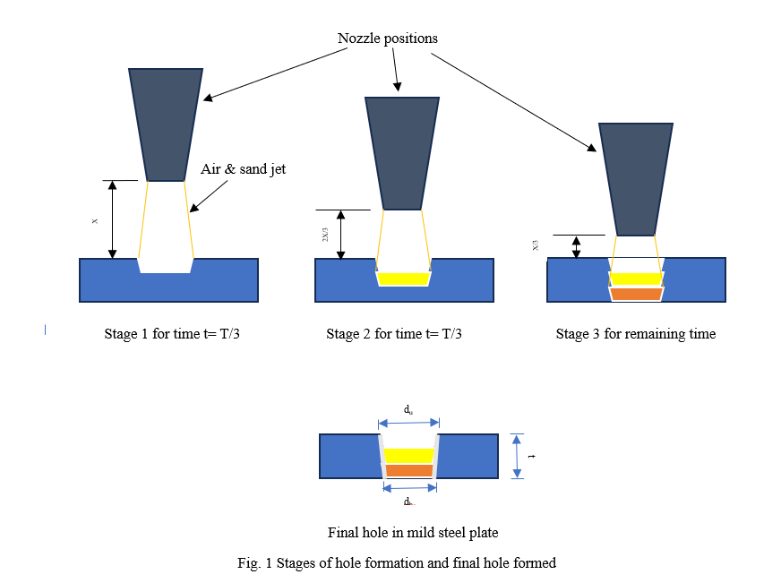
h

Slide 73
Experimental results by first phase DoE
Trial No | Pressure (bar) 1 | Nozzle dia (mm) 2 | SoD (mm) 3 | AFR (g/min) 4 | Weight of nozzle (g) 5 | Job initial weight Wi (g) 6 | Time T (sec) 7 | Job final weight Wf (g) 8 | Hole upper dia (mm) 9 | Hole bottom dia (mm) 10 | MRR (kg/s) 11 | Kerf Taper in degrees 12
1 | 5.515 | 2 | 2 | 46.8 | 46.542 | 48.67 | 450 | 48.57 | 2.8 | 2.56 | 0.00023 | 3.43
2 | 5.515 | 2 | 2 | 46.8 | 46.542 | 48.57 | 450 | 48.46 | 2.76 | 2.46 | 0.00025 | 4.29
3 | 5.515 | 2 | 2 | 46.8 | 46.542 | 48.46 | 600 | 48.30 | 2.6 | 2.52 | 0.00026 | 1.15
4 | 5.515 | 2.5 | 3 | 283.8 | 38.571 | 51.46 | 330 | 51.23 | 4.52 | 2.78 | 0.00068 | 23.51
5 | 5.515 | 2.5 | 3 | 283.8 | 38.571 | 51.23 | 330 | 51.05 | 4.52 | 2.54 | 0.00057 | 26.34
6 | 5.515 | 2.5 | 3 | 283.8 | 38.49 | 51.05 | 330 | 50.87 | 4.42 | 1.78 | 0.00053 | 33.42
7 | 5.515 | 3 | 4 | 470 | 38.68 | 43.47 | 390 | 43.01 | 5.7 | 3.82 | 0.00118 | 25.17
8 | 5.515 | 3 | 4 | 470 | 38.68 | 43.01 | 390 | 42.60 | 5.6 | 3.72 | 0.00106 | 25.17
9 | 5.515 | 3 | 4 | 470 | 38.489 | 42.60 | 330 | 42.23 | 5.6 | 3.5 | 0.00111 | 27.70
10 | 6.5 | 2 | 3 | 470 | 46.542 | 44.10 | 480 | 43.91 | 3 | 2.9 | 0.00040 | 1.43
11 | 6.5 | 2 | 3 | 470 | 46.542 | 43.91 | 510 | 43.77 | 2.82 | 2.7 | 0.00029 | 1.72
12 | 6.5 | 2 | 3 | 470 | 46.542 | 43.77 | 510 | 43.61 | 2.8 | 2.6 | 0.00030 | 2.86
13 | 6.5 | 2.5 | 4 | 46.8 | 60.152 | 44.19 | 360 | 43.94 | 4.6 | 3.52 | 0.00069 | 15.11
14 | 6.5 | 2.5 | 4 | 46.8 | 60.152 | 43.94 | 360 | 43.69 | 4.52 | 3.12 | 0.00069 | 19.29

Slide 74
Trial No | Pressure (bar) 1 | Nozzle dia (mm) 2 | SoD (mm) 3 | AFR (g/min) 4 | Weight of nozzle (g) 5 | Job initial weight Wi (g) 6 | Time T (sec) 7 | Job final weight Wf (g) 8 | Hole upper dia (mm) 9 | Hole bottom dia (mm) 10 | MRR (kg/s) 11 | Kerf Taper in degrees 12
15 | 6.5 | 2.5 | 4 | 46.8 | 60.14 | 43.69 | 360 | 43.41 | 4.1 | 2.92 | 0.00078 | 16.44
16 | 6.5 | 3 | 2 | 283.8 | 38.67 | 35.85 | 360 | 35.44 | 5.38 | 4.1 | 0.00115 | 17.74
17 | 6.5 | 3 | 2 | 283.8 | 38.62 | 35.43 | 330 | 35.07 | 5.38 | 4.14 | 0.00112 | 17.22
18 | 6.5 | 3 | 2 | 283.8 | 38.55 | 35.07 | 300 | 34.74 | 5.36 | 3.54 | 0.0011 | 24.47
19 | 8 | 2 | 4 | 283.8 | 46.54 | 37.66 | 600 | 37.44 | 2.94 | 2.72 | 0.00036 | 3.15
20 | 8 | 2 | 4 | 283.8 | 46.54 | 37.44 | 600 | 37 | 2.92 | 2.86 | 0.00033 | 0.86
21 | 8 | 2 | 4 | 283.8 | 46.54 | 37.24 | 600 | 37.04 | 2.92 | 2.9 | 0.00035 | 0.29
22 | 8 | 2.5 | 2 | 470 | 38.25 | 43.67 | 330 | 43.36 | 5.04 | 3.82 | 0.00096 | 16.96
23 | 8 | 2.5 | 2 | 470 | 38.17 | 43.36 | 330 | 43.01 | 5.64 | 3.74 | 0.00105 | 25.41
24 | 8 | 2.5 | 2 | 470 | 38.14 | 43.01 | 330 | 42.71 | 5.82 | 3.24 | 0.0009 | 32.82
25 | 8 | 3 | 3 | 46.8 | 59.45 | 48.92 | 300 | 48.57 | 5.62 | 4.52 | 0.00117 | 15.38
26 | 8 | 3 | 3 | 46.8 | 59.45 | 48.57 | 300 | 48.24 | 5.38 | 4 | 0.00112 | 19.03
27 | 8 | 3 | 3 | 46.8 | 59.458 | 48.24 | 300 | 47.86 | 5.4 | 4 | 0.00127 | 19.29

Slide 75
Experimental results by second phase DoE
Trial No | Pressure (bar) 1 | Nozzle dia (mm) 2 | SoD (mm) 3 | AFR (g/min) 4 | Weight of nozzle (g) 5 | Job initial weight Wi (g) 6 | Time T (sec) 7 | Job final weight Wf (g) 8 | Hole upper dia (mm) 9 | Hole bottom dia (mm) 10 | MRR (kg/s) 11 | Kerf Taper in degrees 12
1 | 5.515 | 2 | 2 | 46.8 | 51.289 | 44.49 | 540 | 44.35 | 2.8 | 2.74 | 0.00027 | 0.86
2 | 5.515 | 2 | 2 | 46.8 | 51.289 | 44.35 | 600 | 44.18 | 2.78 | 2.62 | 0.00028 | 2.29
3 | 5.515 | 2 | 2 | 46.8 | 51.289 | 44.18 | 660 | 44.05 | 2.92 | 2.82 | 0.00020 | 1.43
4 | 5.515 | 2.5 | 3 | 283.8 | 52.969 | 47.00 | 540 | 46.79 | 3.54 | 3.38 | 0.00038 | 2.29
5 | 5.515 | 2.5 | 3 | 283.8 | 52.969 | 46.79 | 600 | 46.61 | 3.58 | 3.5 | 0.00030 | 1.15
6 | 5.515 | 2.5 | 3 | 283.8 | 52.969 | 46.61 | 660 | 46.42 | 3.54 | 3.46 | 0.00030 | 1.15
7 | 5.515 | 3 | 4 | 470 | 50.042 | 78.42 | 540 | 78.12 | 4.48 | 3.9 | 0.00056 | 8.25
8 | 5.515 | 3 | 4 | 470 | 50.042 | 78.12 | 600 | 77.81 | 4.26 | 4 | 0.00051 | 3.72
9 | 5.515 | 3 | 4 | 470 | 50.042 | 77.81 | 660 | 77.50 | 4.3 | 4.06 | 0.00048 | 3.43
10 | 6.5 | 2 | 3 | 470 | 51.289 | 44.94 | 540 | 44.80 | 3.1 | 3.04 | 0.00027 | 0.86
11 | 6.5 | 2 | 3 | 470 | 51.289 | 44.80 | 600 | 44.65 | 3 | 2.78 | 0.00025 | 3.15
12 | 6.5 | 2 | 3 | 470 | 51.289 | 44.65 | 660 | 44.49 | 3.16 | 3.14 | 0.00023 | 0.29

Slide 76
Trial No | Pressure (bar) 1 | Nozzle dia (mm) 2 | SoD (mm) 3 | AFR (g/min) 4 | Weight of nozzle (g) 5 | Job initial weight Wi (g) 6 | Time T (sec) 7 | Job final weight Wf (g) 8 | Hole upper dia (mm) 9 | Hole bottom dia (mm) 10 | MRR (kg/s) 11 | Kerf Taper in degrees 12
13 | 6.5 | 2.5 | 4 | 46.8 | 52.969 | 43.72 | 540 | 43.46 | 3.8 | 3.72 | 0.00048 | 1.15
14 | 6.5 | 2.5 | 4 | 46.8 | 52.969 | 43.46 | 600 | 43.17 | 3.9 | 3.8 | 0.00049 | 1.43
15 | 6.5 | 2.5 | 4 | 46.8 | 52.969 | 43.17 | 660 | 42.86 | 3.9 | 3.78 | 0.00047 | 1.72
16 | 6.5 | 3 | 2 | 283.8 | 49.991 | 45.52 | 540 | 45.26 | 3.9 | 3.82 | 0.00047 | 1.15
17 | 6.5 | 3 | 2 | 283.8 | 49.991 | 45.26 | 600 | 45.02 | 3.82 | 3.74 | 0.00041 | 1.15
18 | 6.5 | 3 | 2 | 283.8 | 49.991 | 45.02 | 660 | 44.74 | 3.84 | 3.78 | 0.00042 | 0.86
19 | 8 | 2 | 4 | 283.8 | 51.289 | 45.74 | 540 | 45.50 | 3.3 | 2.5 | 0.00044 | 11.31
20 | 8 | 2 | 4 | 283.8 | 51.289 | 45.50 | 600 | 45.28 | 3.28 | 3.22 | 0.00037 | 0.86
21 | 8 | 2 | 4 | 283.8 | 51.289 | 45.28 | 660 | 45.04 | 3.3 | 3 | 0.00037 | 4.29
22 | 8 | 2.5 | 2 | 470 | 52.928 | 46.42 | 540 | 46.21 | 3.5 | 3.44 | 0.00038 | 0.86
23 | 8 | 2.5 | 2 | 470 | 52.928 | 46.21 | 600 | 45.95 | 3.5 | 3.46 | 0.00043 | 0.57
24 | 8 | 2.5 | 2 | 470 | 52.928 | 45.95 | 660 | 45.75 | 3.4 | 3.36 | 0.00032 | 0.57
25 | 8 | 3 | 3 | 46.8 | 49.991 | 44.73 | 540 | 44.14 | 4.1 | 4.06 | 0.00109 | 0.57
26 | 8 | 3 | 3 | 46.8 | 49.991 | 44.14 | 600 | 44.06 | 4.2 | 4.16 | 0.00013 | 0.57
27 | 8 | 3 | 3 | 46.8 | 49.991 | 44.06 | 660 | 43.74 | 4.2 | 4.08 | 0.00049 | 1.72

Slide 77
Statistical Analysis for MRR and Kerf Taper Optimization
Reduction of Kerf Taper in Abrasive Jet Machining

Slide 78
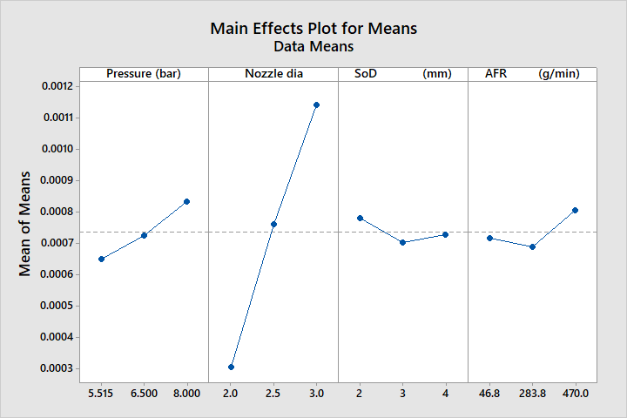
Analysis of first Taguchi experiment for maximizing Material Removal Rate (MRR)
Fig. 2. Main effects plot for means as per first Taguchi Experiment

Slide 79
Fig. 3. Main effects plot for SN ratios as per first Taguchi Experiment

Slide 80
Analysis of First Taguchi Experiment for MRR
• Nozzle Diameter: Most influential factor for MRR.
- Optimal: 3.0 mm (highest SN ratio: -58.87).
• Pressure: Second most influential factor.
- Optimal: 8.000 bar.
• AFR: Third most influential factor.
- Optimal: 470 g/min.
• SoD: Least influential factor.
- Minimal impact on MRR.
Optimal Settings:
• Nozzle Diameter: 3.0 mm
• Pressure: 8.000 bar
• AFR: 470 g/min
• SoD: 3 mm

Slide 81
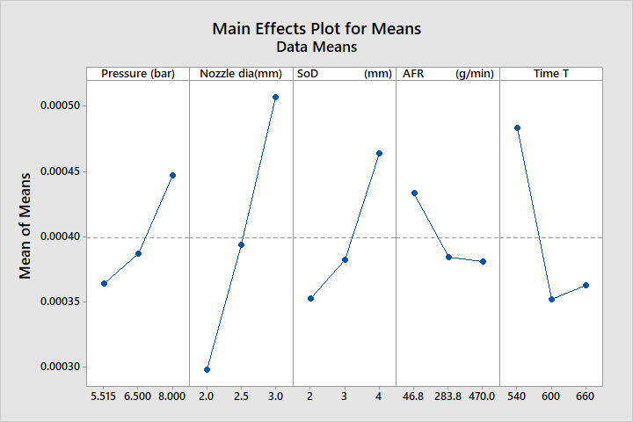
Main effects plot for means as per second Taguchi Experiment
Fig. 4. Main effects plot for means as per second Taguchi Experiment

Slide 82
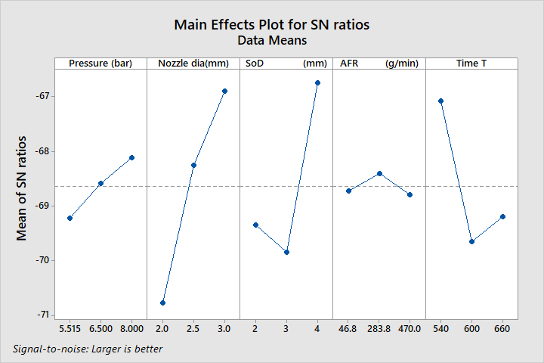
Fig. 5. Main effects plot for SN ratios as per second Taguchi Experiment

Slide 83
Analysis of Second Taguchi Experiment for MRR
• Nozzle Diameter: Most significant factor.
- Optimal: 3.0 mm.
• SoD: Second most influential factor.
- Optimal: 4 mm.
• Time: Third most influential factor.
- Optimal: 540 seconds.
• Pressure: Moderate impact.
- Optimal: 8.000 bar.
• AFR: Least influential factor.
- Optimal: 283.8 g/min.
Optimal Settings:
• Nozzle Diameter: 3.0 mm
• SoD: 4 mm
• Time: 540 seconds
• Pressure: 8.000 bar
• AFR: 283.8 g/min

Slide 84
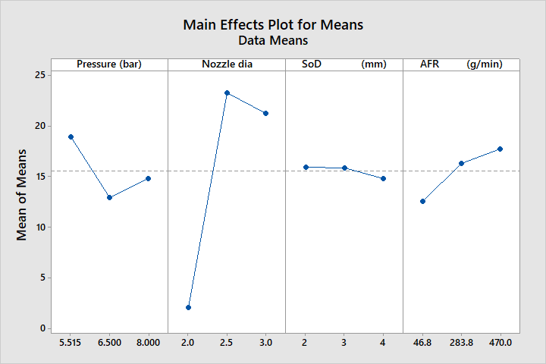
Main effects plot for means as per first Taguchi Experiment to minimize Kerf taper
Fig. 6. Main effects plot for means as per first Taguchi Experiment

Slide 85
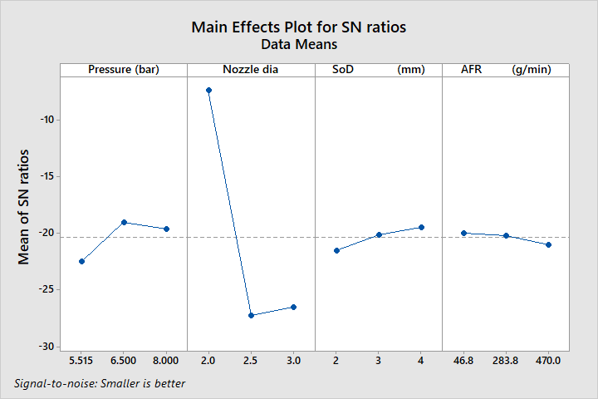
Fig. 7. Main effects plot for SN ratios as per first Taguchi Experiment

Slide 86
Analysis of First Taguchi Experiment for Kerf Taper
• Nozzle Diameter: Most influential factor
- Optimal: 2.5 mm
• Pressure: Second most influential factor
- Optimal: 6.500 bar
• SoD: Minimal impact
- Optimal: 3 mm
• AFR: Least influential factor
- Optimal: 283.8 g/min
Optimal Settings:
• Nozzle Diameter: 2.5 mm
• Pressure: 6.500 bar
• SoD: 3 mm
• AFR: 283.8 g/min

Slide 87
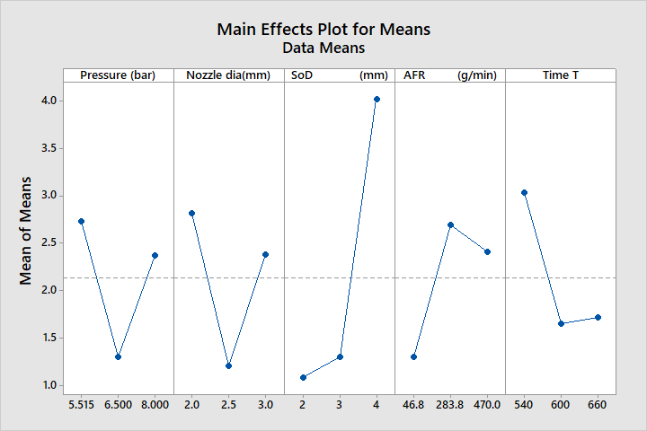
Analysis of second Taguchi experiment for minimizing Kerf taper
Fig. 8. Main effects plot for means as per second Taguchi Experiment

Slide 88
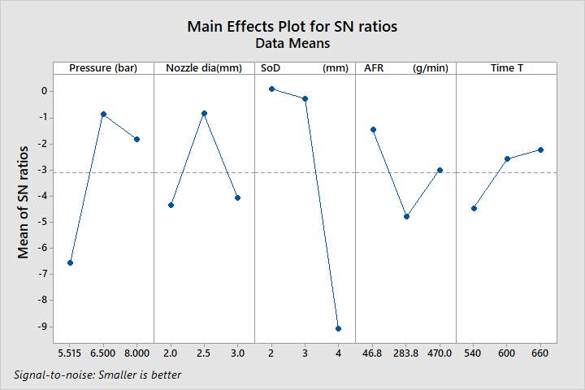
Fig. 9. Main effects plot for SN ratios as per second Taguchi Experiment

Slide 89
Analysis of Second Taguchi Experiment for Kerf Taper
• SoD: Most influential factor
- Optimal: 2 mm.
• Nozzle Diameter: Second most influential factor.
- Optimal: 2.5 mm.
• Pressure: Third most influential factor.
- Optimal: 6.500 bar.
• AFR: Moderate impact.
- Optimal: 283.8 g/min.
• Time: Least influential factor.
- Optimal: 600 seconds.
Optimal Settings:
• SoD: 2 mm
• Nozzle Diameter: 2.5 mm
• Pressure: 6.500 bar
• AFR: 283.8 g/min
• Time: 600 seconds

Slide 90
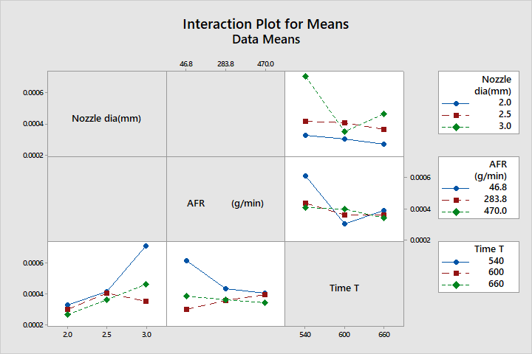
Interaction effects observations based on interaction plots for Means and SN Ratios for maximizing MRR:
Fig. 10. Interaction plot for means as per second Taguchi Experiment

Slide 91
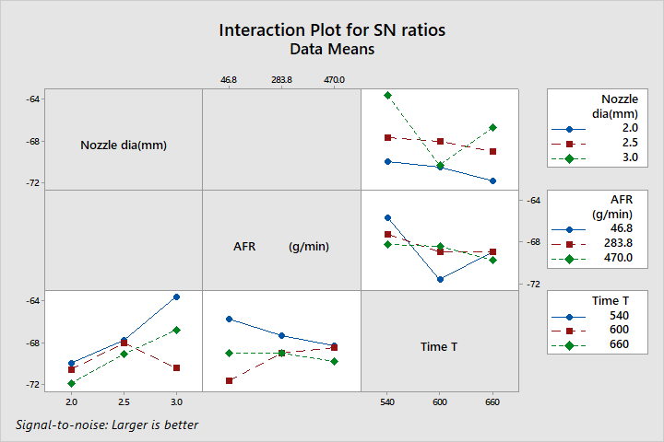
Fig. 11. Interaction plot for SN ratios as per second Taguchi Experiment

Slide 92
Interaction Effects for MRR
• Nozzle Diameter and AFR:
- Optimal: 3.0 mm nozzle with 283.8 g/min AFR
.
• Nozzle Diameter and Time:
- Optimal: 3.0 mm nozzle with 540 seconds.
• AFR and Time:
- Optimal: 283.8 g/min AFR with 540 seconds.

Slide 93
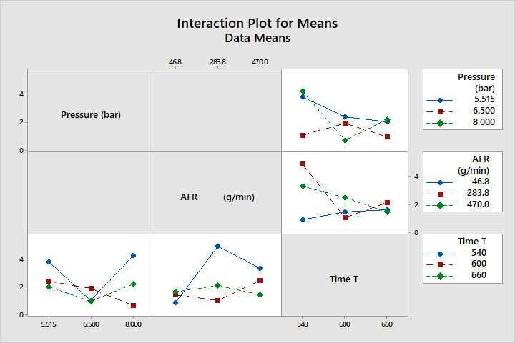
Interaction effects observations based on interaction plots for Means and SN Ratios for minimising kerf taper
Fig. 12. Interaction plot for means as per second Taguchi Experiment

Slide 94
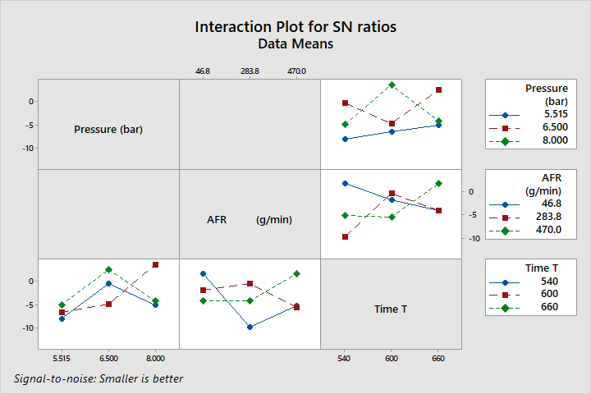
Fig. 13. Interaction plot for SN Ratios as per second Taguchi Experiment

Slide 95
Interaction Effects for Kerf Taper
• Pressure and AFR:
- Optimal: 6.500 bar pressure with 283.8 g/min AFR
.
• Pressure and Time:
- Optimal: 6.500 bar pressure with 600 seconds.
• AFR and Time:
- Optimal: 283.8 g/min AFR with 600 seconds.

Slide 96
Summary of Optimal Settings
Case | Pressure (bar) | Nozzle Diameter (mm) | Stand-off Distance (SoD) (mm) | Abrasive Flow Rate (AFR) (g/min) | Time of Jet Impact (Time T in sec)
1. Optimum MRR using First Taguchi Experiment | 8 | 3 | 3 | 470
2. Optimum MRR using Second Taguchi Experiment | 8 | 3 | 4 | 283.8 | 540
3. Optimum MRR using Second Taguchi Experiment (Main & Interaction Effects) | 8 | 3 | 4 | 283.8 | 540
3. Optimum Kerf Taper using First Taguchi Experiment | 6.5 | 2.5 | 3 | 283.8
4. Optimum Kerf Taper using Second Taguchi Experiment (Main Effects Only) | 6.5 | 2.5 | 3 | 283.8 | 600
5. Optimum Kerf Taper using Second Taguchi Experiment (Main & Interaction Effects) | 6.5 | 2.5 | 2 | 283.8 | 600

Slide 97
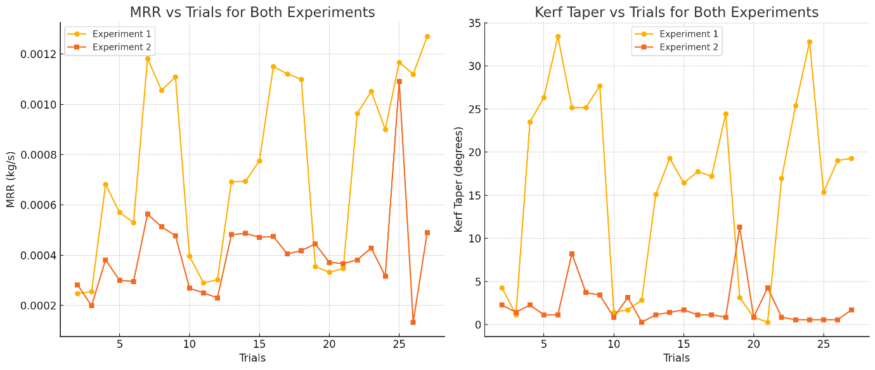
(a) (b)
Fig.14. (a), (b) Graphical plots of comparative view of MRR and Kerf Taper across trials for both Taguchi experiments

Slide 98
Comparative Analysis of MRR and Kerf Taper:
• MRR vs Trials:
Experiment 1: Higher variability in MRR across trials; inconsistent performance
Experiment 2: Lower MRR values but more consistent results with reduced
fluctuation
• Kerf Taper vs Trials:
Experiment 1: Significant variability with high peaks; less control over taper
minimization
Experiment 2: More consistent and lower kerf taper across trials; better optimization

Slide 99
Conclusion
• Introduced a novel approach to reduce kerf taper in AJM by dynamically adjusting SoD and optimizing impingement time.
• Successfully utilized locally sourced seashore sand as a cost-effective abrasive material.
• Key Outcomes:
- Reduced kerf taper from 33.4° to 8.25°.
- Identified SoD and nozzle diameter as the most influential factors.
• Industry Impact:
- Scalable, cost-effective solution for high-precision machining.
- Potential for further research into real-time parameter control.

Slide 100
References:
1. Melentiev, R. and Fang, F., 2021. Prediction of crater depth, surface roughness, and erosion rate during abrasive jet machining of glass. Wear, 468, p.203-596. https://doi.org/10.1016/j.wear.2020.203596
Jafar, R.H.M., 2013. Erosion and Roughness Modeling in Abrasive Jet Micro-Machining of Brittle Materials (Doctoral dissertation, University of Toronto).
Li, H.Z., Wang, J. and Fan, J.M., 2009. Analysis and modelling of particle velocities in micro-abrasive air jet. International Journal of Machine Tools and Manufacture, 49(11), pp.850-858. https://doi.org/10.1016/j.ijmachtools.2009.05.012
Verspui, M.A., de With, G., Corbijn, A. and Slikkerveer, P.J., 1999. Simulation model for the erosion of brittle materials. Wear, 233, pp.436-443. https://doi.org/10.1016/S0043-1648(99)00180-5
Jafar, R.H.M., Nouraei, H., Emamifar, M., Papini, M. and Spelt, J.K., 2015. Erosion modeling in abrasive slurry jet micro-machining of brittle materials. Journal of Manufacturing Processes, 17, pp.127-140. https://doi.org/10.1016/j.jmapro.2014.08.006
Hadavi, V., Arani, N.H. and Papini, M., 2019. Numerical and experimental investigations of particle embedment during the incubation period in the solid particle erosion of ductile materials. Tribology International, 129, pp.38-45. https://doi.org/10.1016/j.triboint.2018.08.013
Zhu, G., Li, H., Zhang, T. and Liu, M., 2021. Modeling and simulation of micro-hole fabrication on brittle material using abrasive air jet machining. Journal of Manufacturing Processes, 72, pp.361-374. https://doi.org/10.1016/j.jmapro.2021.10.036

Slide 101
8. Tsai, F.C., Yan, B.H., Kuan, C.Y. and Huang, F.Y., 2008. A Taguchi and experimental investigation into the optimal processing conditions for the abrasive jet polishing of SKD61 mold steel. International Journal of Machine Tools and Manufacture, 48(7-8), pp.932-945. https://doi.org/10.1016/j.ijmachtools.2007.08.019
9. Suresh, R., Reddy, K.S. and Shapur, K., 2018. Abrasive jet machining for micro-hole drilling on glass and GFRP composites. Materials Today: Proceedings, 5(2), pp.5757-5761. https://doi.org/10.1016/j.matpr.2017.12.171
10. Srikanth, D.V. and Rao, M.S., 2015. Application of Taguchi & response surface methodology in optimization for machining of ceramics with abrasive jet machining. Materials Today: Proceedings, 2(4-5), pp.3308-3317. https://doi.org/10.1016/j.matpr.2015.07.149
11. Nayak, B.B., Abhishek, K., Mahapatra, S.S. and Das, D., 2018. Application of WPCA-based Taguchi method for multi-response optimization of abrasive jet machining process. Materials Today: Proceedings, 5(2), pp.5138-5144. https://doi.org/10.1016/j.matpr.2017.12.09520220721
12. Kumar, N.S. and Sozhamannan, G.G., 2022. Effect of process parameters on Mg/Gr (MMC) and GFRP by using abrasive air jet machine. Materials Today: Proceedings. https://doi.org/10.1016/j.matpr.2022.08.229
13. Khodke, P.M., Tidke, D.J. and Ramarao, A.V., 1996. An analytical model for material removal in abrasive jet machining for brittle materials. Material and Manufacturing Process, 11(4), pp.535-554. https://doi.org/10.1080/10426919608947507
14. Ghara, T., Paul, S. and Bandyopadhyay, P.P., 2022. Analytical and experimental analysis of indentation depth upon abrasive impact on metallic substrates. Materials Chemistry and Physics, 280, p.125865. https://doi.org/10.1016/j.matchemphys.2022.125865

Slide 102
15. Prasad, K.N., Basha, D.J. and Varaprasad, K.C., 2017. Experimental investigation and analysis of process parameters in abrasive jet machining of Ti-6Al-4V alloy using Taguchi method. Materials Today: Proceedings, 4(10), pp.10894-10903.
https://doi.org/10.1016/j.matpr.2017.08.044
16. Wang, Z., Li, H., Yu, T.B., Chen, H. and Zhao, J., 2019. On the predictive modeling of machined surface topography in abrasive air jet polishing of quartz glass. International Journal of Mechanical Sciences, 152, pp.1-18. https://doi.org/10.1016/j.ijmecsci.2018.12.041
17. Anjaneyulu, P., et al., 2019. Taguchi-Based Optimization of AJM Parameters for Al2O3 Ceramics. Journal of Mechanical Science and Technology.
18. Popan, I.A., Bocănet, V.I., Softic, S., et al. (2024). Artificial Intelligence Model Used for Optimizing Abrasive Water Jet Machining Parameters to Minimize Delamination in Carbon Fiber-Reinforced Polymers. Machines.
19. Popan, I.A., Bocănet, V.I., Softic, S., et al. (2024). Artificial Intelligence Model Used for Optimizing Abrasive Water Jet Machining Parameters to Minimize Delamination in Carbon Fiber-Reinforced Polymers. Machines.
20. Jafar, R.H.M., Papini, M. and Spelt, J.K., 2013. Simulation of erosive smoothing in the abrasive jet micro-machining of glass. Journal of Materials Processing Technology, 213(12), pp.2254-2261. https://doi.org/10.1016/j.jmatprotec.2013.06.022
21. Du, M., Zhang, K., Liu, Y., Feng, L., & Fan, C. (2022). Experimental and simulation study on the influence factors of abrasive water jet machining ductile materials. Energy Reports, 8, 11840-11857. https://doi.org/10.1016/j.egyr.2022.09.062

Slide 103
22. Shi, H., Giasin, K., Barouni, A., & Zhang, Z. (2024). An experimental assessment and optimization of hole quality in Al2024 T3 aluminum alloy during abrasive water jet machining. The International Journal of Advanced Manufacturing Technology, 130, 5199–5218. https://doi.org/10.1007/s00170-024-13009-9
23.Holmberg, J., Wretland, A., & Berglund, J., 2022. Abrasive water jet milling as an efficient manufacturing method for superalloy gas turbine components. Journal of Manufacturing and Materials Processing, 6(5), 124. https://doi.org/10.3390/jmmp6050124
24.Tamilarasan, A., Renugambal, A., & Shunmugesh, K., 2023. Multi-performance optimization for AWJ drilling process in cutting of ceramic tile: BBD with EOBL-GOA algorithm. Multidiscipline Modeling in Materials and Structures.
25.Wakuda, M., Yamauchi, Y., & Kanzaki, S., 2002. Effect of workpiece properties on machinability in abrasive jet machining of ceramic materials. Precision Engineering, 26(2), 193-198.
26. Ambade, S.P., Tembhurkar, C.K., & Shelare, S. (2022). Application of ANN and Taguchi Technique for Material Removal Rate by Abrasive Jet Machining with Special Abrasive Materials. Journal of Material Removal.
27. Anjaneyulu, P., Muthukumaran, N., Samy, M.M. (2021). Investigation on Effect of Process Parameters in Abrasive Jet Machining Process Using Full Factorial Design. Materials Today: Proceedings.
jet machining.

Slide 104
28.Pradhan, S., Sahu, S., Das, S.R., 2021. Simulation of Surface Generation During Machining of K-80 Alumina Ceramic in Modified Abrasive Jet Machining with Different Temperatures Using Al2O3 Abrasives. Journal of Abrasive Technology.
29. Slătineanu, L., Coteaţă, M., Pop, N., Mazuru, S., Coelho, A., & Beşliu, I., 2009. Impact phenomena at the abrasive 30.Fan, J.M., Wang, C.Y., & Wang, J., 2009. Modelling the erosion rate in micro abrasive air jet machining of glasses. Wear, 266(9-10), 968-974. https://doi.org/10.1016/j.wear.2008.12.019
31.Wang, Z., Li, H., Yu, T., Chen, H., Zhao, J., 2019. Predictive modelling of machined surface topography in abrasive air jet polishing of quartz glass. International Journal of Mechanical Sciences, 152, pp.1-18. https://doi.org/10.1016/j.ijmecsci.2018.12.041
32.Burzynski, T. and Papini, M., 2012. Modelling of surface evolution in abrasive jet micro-machining including particle second strikes: A level set methodology. Journal of Materials Processing Technology, 212(5), pp.1177-1190. https://doi.org/10.1016/j.jmatprotec.2012.01.002
33.Levin, B.F., DuPont, J.N., & Marder, A.R., 2000. Indentation analysis of sub-surface deformation in ductile materials after solid particle erosion. Materials Science and Engineering: A, 283(1-2), pp.203-210. https://doi.org/10.1016/S0921-5093(99)00776-5

